Slide 1

Workshop Housekeeping Python Fundamentals for Engineers and Manufacturers

Slide 2

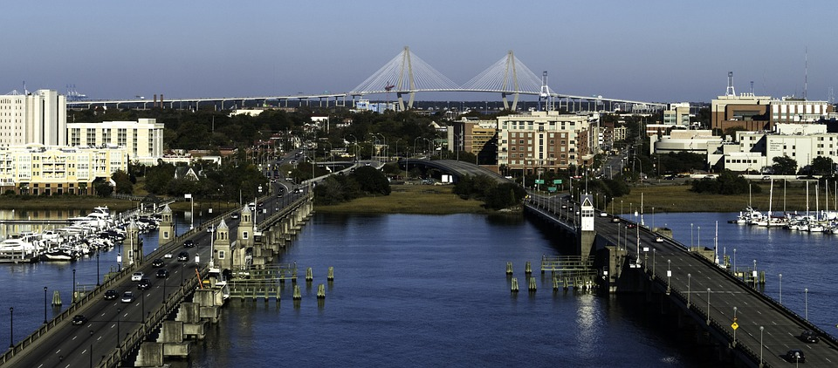
Hosted By
Workshop repo
http://bit.ly/2opFlZ6
SME Chapter 112
Chicagoland
SME Chapter 430
Greater Charleston

Slide 3
Where is all the info for this workshop?
http://bit.ly/2opFlZ6
All code is licensed under The MIT License.
All written content is licensed under Creative Commons Attribution 4.0 International Public License.

Slide 4
Workshops are just the beginning.
Workshop repo
http://bit.ly/2opFlZ6
Open-source projects on GitHub.
Targeted webinars on YouTube.
Real-world, industry use-cases on YouTube. Check out http://bit.ly/2FlcOxG.
Industrial hardware/software hackathons.
Virtual assistance with SME student chapter projects.
Live stream coding sessions on YouTube.

Slide 5
Feedback
Workshop repo
http://bit.ly/2opFlZ6
We
feedback and suggestions!
http://bit.ly/2G42GXy

Slide 6
Robot Operating System http://www.ros.org/
OpenCV
https://opencv.org/
CUDA
http://bit.ly/2F9tpkH
NVIDIA Jetson Boards
http://bit.ly/2FOnx1f

Slide 7
PX4 – Flight Stack and Autonomous Middleware
http://px4.io/

Slide 8
OpenCV
https://opencv.org/
NVIDIA Jetson Boards
http://bit.ly/2FOnx1f

Slide 9
CARLA
http://www.carla.org/
Udacity Self-Driving Simulator
http://bit.ly/2oKNKFY
Unity
https://unity3d.com/

Slide 10
Python Topics - Fundamentals
Workshop repo
http://bit.ly/2opFlZ6
Introduction to Git. Check out https://bit.ly/2teAz5x.
Introduction to Anaconda, the Python interpreter and the pip ecosystem.
Introduction to Jupyter Notebooks and Visual Studio Code.
Data types and objects.
Reading and writing data.
Control flow.
Loops and iterables.
Functions.
Classes.
Packages.

Slide 11
Python Topics - Intermediate
Workshop repo
http://bit.ly/2opFlZ6
Documentation.
Testing.
Debugging.
Profiling.
Network communication.
Data exploration and visualization (with NumPy and Pandas).

Slide 12
Workshop Outline – Advanced
Workshop repo
http://bit.ly/2opFlZ6
Concurrency and parallelism.
Hardware description and verification (HDL).
Computational geometry (pretty good video here).
Image manipulation and machine vision.
Neural networks (CNN or ConvNet).
Check out the TensorFlow Playground.

Slide 13
All SME Virtual Network projects will support labels on issues.
You can “claim” an issue by adding a comment to the issue which contains the word claim.
Want a list of other “beginner-friendly” Python open-source projects? http://bit.ly/2Fb2KUM

Slide 14








Anaconda Ecosystem
Anaconda Cloud
conda install -c <channel> <package name>
Anaconda
Python Interpreter
Applications
Libraries

Slide 15
Python Virtual Environments

Slide 16
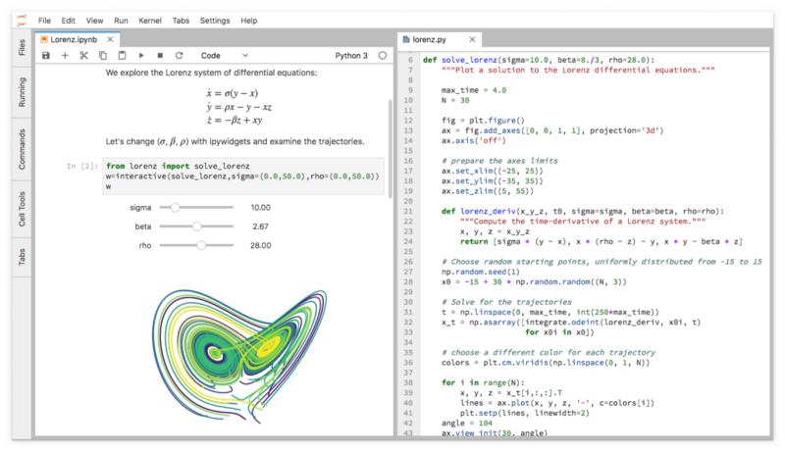
JupyterLab
Install JupyterLab into your Anaconda install: conda install –c conda-forge jupyterlab The actual Anaconda Cloud entry is here: http://bit.ly/2Facu5r

